Slide 1
POVRAY Project
Team Q
The fall of civilization
David Orlando de la Fuente Garza - A00817582
José María Flores Escalera - A01153458
Diego Adolfo José Villa - A00815260

Slide 2
Introduction

Slide 3
Introduction
We wanted to create a post-apocalyptic sCENE consisting of elements such as floods, SCARCE RESOURCES AND DISTANT HOUSES.
This scene helps us exemplify the relation between the overconsumption of resources and the end of the world due to its exploitation, a common practice of the last few decades.
Using modern elements, we wanted to show how the act of consuming, as by use, decay or destruction could impact our way of living.

Slide 4
Introduction
We wanted to have all the elements A common post-apocalyptic sCENE usually has Like a vision of the aftermath – and provide some thoughts on the apocalypse, on humankind survival or fight, on individual’s or community/group’s life, reactions and emotional dynamics.

Slide 5
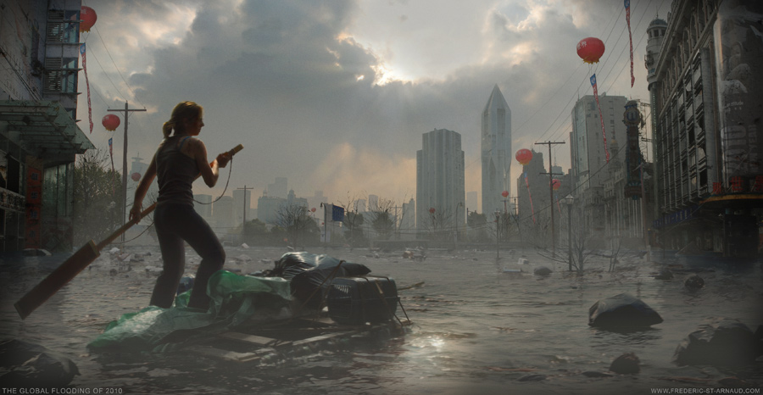
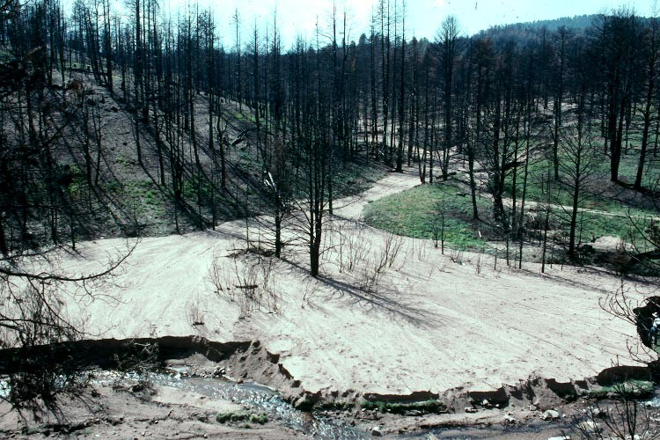
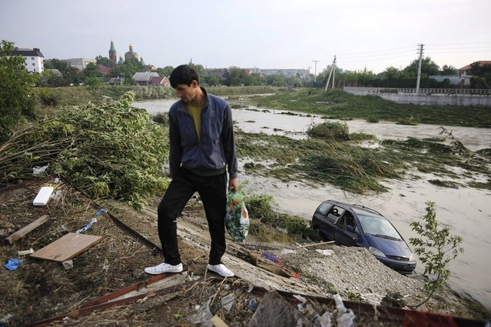
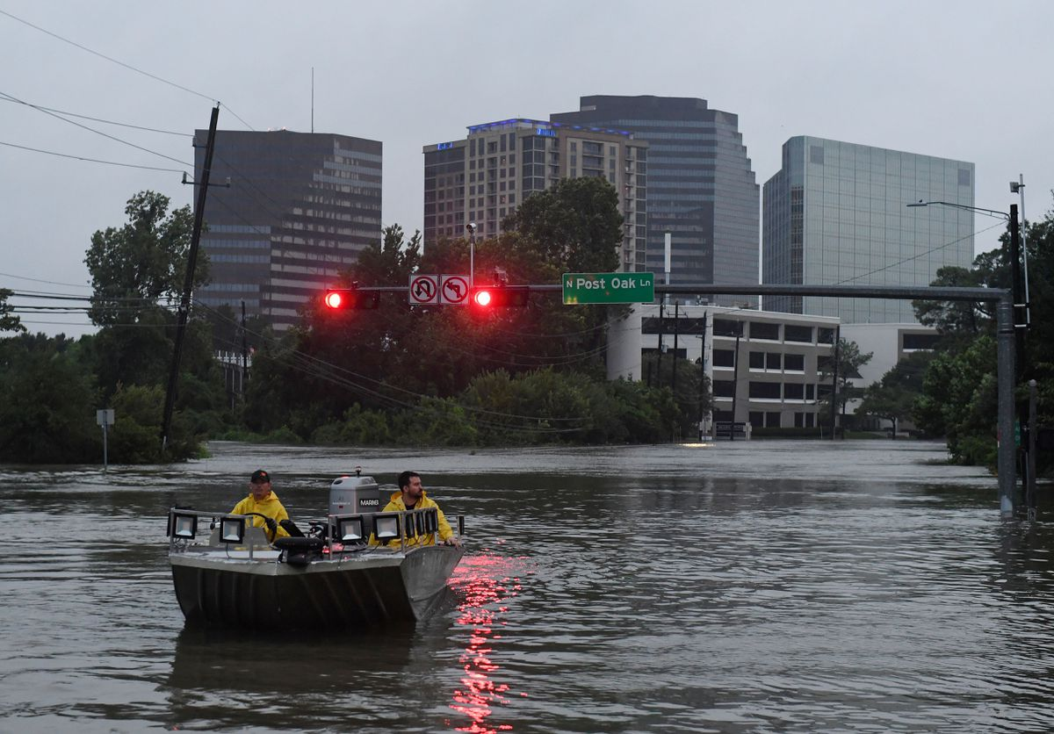
INSPIRATION FOR OUR SCENE

Slide 6
Modelling

Slide 7
List of Original Models
IN ORDER TO BRING THE SCENE TO LIFE, WE NEEDED THE FOLLOWING ELEMENTS WHICH WE MODELED OURSELVES:
A MOUNTAIN TERRAIN (USING the MIDPOINT DISPLACEMENT algorithm TO CREATE it)
Different TREES (USING THE ArBARO PLUG-IN)
CONTAMINATED FRUIT
A POLLUTED SKY (Using a Julia fractal to show the Ozone layer depletion)
A water surface that surrounds the mountain top (submerged mountain)
Fog that surrounded the scene
How the principles of realism and how the fractals were made are described later on their own sections.

Slide 8
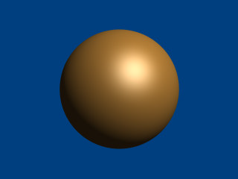

Modelling – Contaminated fruit
We useD primitive meshes (Spheres) To generate the contaminated fruit models. These have fallen from the dead trees on the mountain top.
In order to give them a realistic feeling, we applied an orange fractal texture alongside brighter red colors.
We intend to transmit a sense of how objects on the scene have decayed over time from the human impact, USING THE SCALE FUNCTION TO GIVE THEM THEIR CORRESPONDING SIZE AND GEOMERTRY to an ordinary fruit. These were placed near trees which they fell from.

Slide 9
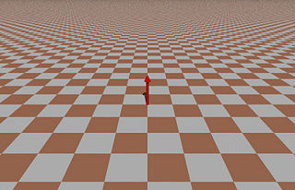
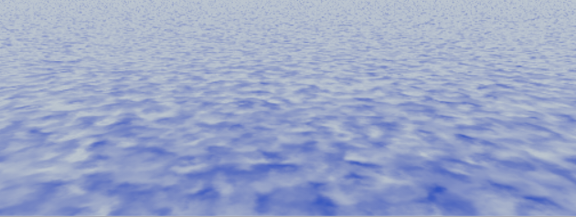
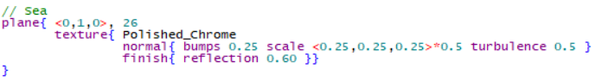
Modelling – Water surface
In order to create a realistic sea, we used a basic plane mesh and added a natural water texture (polished chrome with bumps and turbulence).
This would create the illusion of water alongside its natural reflection.
We scaled the size and its geometry and placed the plane in our scene so it would surround the mountain object.
The scale of the surface is the biggest on our scene as it should look like a island without any sort of communication.

Slide 10


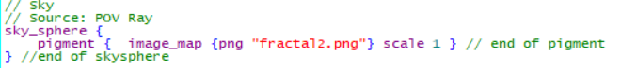
Modelling – Polluted sky
For the polluted sky, we created a simple sky sphere mesh, which would immediately create the perception effect of a realistic sky.
Then, we user image_map to place the image of our fractal created using Julia. This gives it a sensation of an abnormal sky, as it was contaminated by chemicals and Industrial gases.
We scaled the size of The sky Sphere and placed it surrounding the whole scene, Covering all the other objects inside, just like the water surface. Both of these objects form the general landscape of the scene.

Slide 11
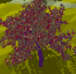
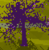
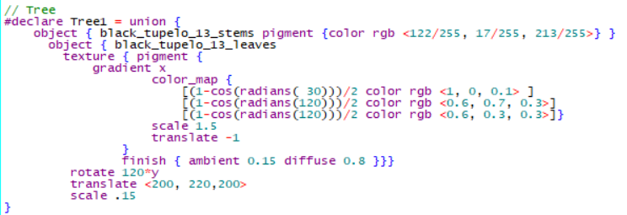
Modelling - Trees with ARbaro
We created trees using the Arbaro plug-in, trees were composed by the union of black_tupelo_13_stems and black_tupelo_13_leaves.
In the scene we included both trees with leaves and trees without them. This was done with the purpose of reinforcing the drastic consequences nature has endured.

Slide 12
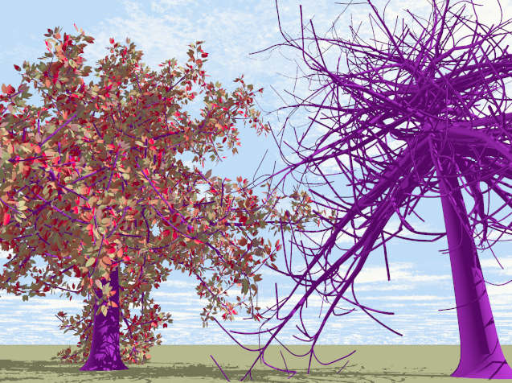
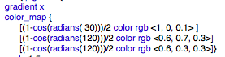
Modelling - Trees with ARbaro
We modified some values to generate more realistic sized trees according to our scene and scaled and placed them randomly on the surface of the mountain.
We chose how many levels the trees would have and how the leaves would interact with them.
For the color of the leaves we used color mapping that showed how ill the trees that still exist are.
Due to its sporadic placement, some trees are closer to each other than others. Also, we placed trees without leaves near the rotten fruit to indicate that both have taken toll from the contamination.

Slide 13
List of Imported Models
A few objects within the scene were too complicated to model within the timeframe given so they were imported from outside sources:
A HOUSE
A BOAT
All of them were taken with authorization within Creative Commons from objects.povworld.org and are credited at the end of this presentation in order to give them their full description.

Slide 14
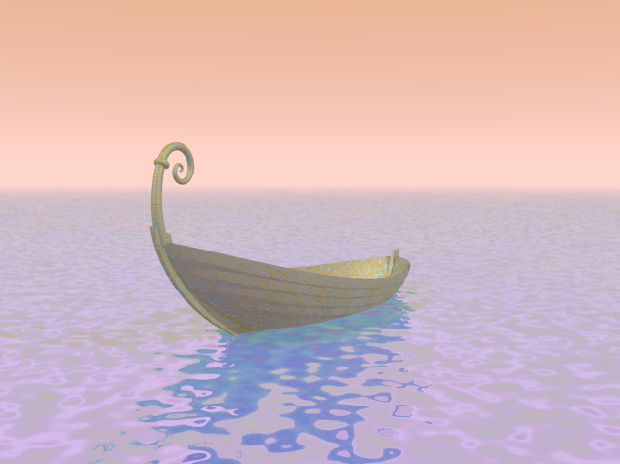
Imported Models - bOAT
We used the model of a little fantasy boat, imported it and adapted it to the scene.
IT WAS SIZED TO GIVE IT A NATURAL LOOK AND PLACED IT AS IT WAS DOCKED NEAR THE MOUNTAIN TOP.

Slide 15
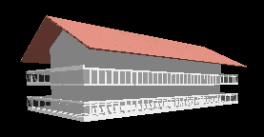
Imported Models - hOUSE
We used the model of a house from a lighthouse project made by Bob Hughes, imported it and adapted it to the scene.
IT WAS SEIZED AND PLACED behind the top of the mountain, making it look as the last habitable place on the scene.

Slide 16
Layout and Composition
The general layout is a post-apocalyptic WORLD where people ARE STRANDED IN THE TOP OF A MOUNTAIN WITH ALMOST NO RESOURCES, BREATHING THE POLLUTED AIR AND BEING SURROUNDED BY A FLOOD THAT HAS BLOCKED ANY WALKING PATH TO SURVIVAL.
A SCENE FULL Of DESPAIR IS MEET WITH ITS ONLY HOPE IN A BOAT IN WHICH PEOPLE CAN TRAVEL IN, KNOWING THEY COULD EITHER WAIT FOR HELP OR TRY TO FIGHT AND HOPE TO FIND NEARBY SHELTER THEY COULD REACH BY BOAT.

Slide 17
Layout and Composition
The main focus is the space between the MAIN mountain top and ITS immediate surroundings Areas AND OBJECTS.
The main mountain top is surrounded by a plane with realistic water while the Sun, the main source of light, is perpendicular and above both. The size and texTUres used of the objects within the scene gives them a realistic look compared to a normal mountain and water .

Slide 18
Layout and Composition
The boat is placed to the side of the mountain top to show that is docked and ready to be used if the people on the mountain decide to do it. The boat looks to be made from the same wood of the trees on the mountain.
The trees are placed on the island sporadically and randomly on the surface of the mountain to justify the realism of the scene. We gave them a realistic look by placing trees without leaves due to the disaster that took place. We GAVE THEM A brown, green, purple and orange COLOR textures AS THEY WERE IN REAL LIFE during autumn.

Slide 19
Layout and Composition
The house is placed on a flat surface on the mountain and is big enough to CONTAIN DIFFERENT OBJECTS to satisfy people’s necessities for a short time.
The small island itself is surrounded with fog to give it a sense of mystery from the events that took palce.

Slide 20
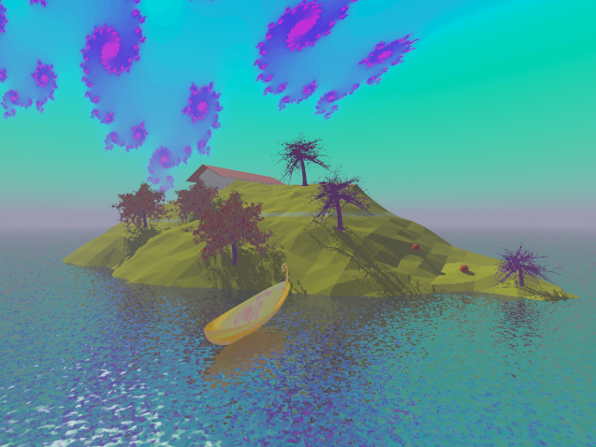
Layout and Composition
A look into ALL the models’ location, size, orientation and distance to others.

Slide 21
Important Elements
We added to following elements to help us to transmit our message:
A House that represents The timed safety that a survivor would have, placing him with the decision of waiting to be rescued or adventure froth to unknown land. making decisions can be a fundamental burden on everyone’s daily life.
A Boat that represents hope and the option to escape from the despair of the current situation. We tend to rely on even the smallest amount of hope even in the most dire situtations.

Slide 22
Important Elements
Trees show the past way of life and the lvingin creatures that once walked on land.
The flood and air pollution show the damage done to the environment leading to this catastrofe.
All these elements represent a drastic but possible fate on earth from the consequences of climate change and how our current actions might not be enough in time to prevent it. This leads to a call for attention to this subject.

Slide 23
FRACTALS – Julia Fractal
In order To create the Julia Fractal we need to:
Iterate over all the pixels of our image using two nested loops. The first loop is for the x position and the second loop is for the y position.
In our case we did the code in Java, so we need to compute the first value for the real and the imaginary part of z. This step allow us to get a value in a fixed range between -1 and 1. With this setting, the fractal does not depend on the dimensions of the image.

Slide 24
FRACTALS – Julia Fractal
Then, we are going to calculate new values for z as long as the position of the pixel is within a circle of radius 2 or the number of iterations is greater than 0.
When the condition of the cycle is not fulfilled, the iteration variable will have the value of the number of iterations remaining. We are going to use this value to get a color.

Slide 25
FRACTALS – Julia Fractal
To compute a color, we are going to divide the total number of iterations by the number of remaining iterations. We need to get a value between 0 and 1, so we need to apply the mod operator. The result of this operation is A hue in a HSB model. We need to convert this value to a RGB model and paint the pixel with the corresponding color.
To change the color of the fractal, we added a value to the remaining iterations.

Slide 26
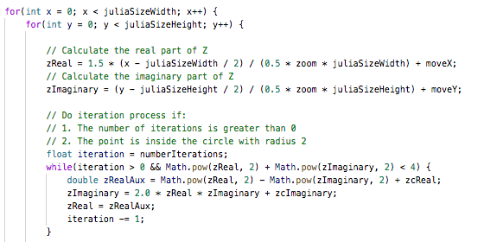
FRACTALS – Julia Fractal
The following is a part of our Julia fractal, doing what was previously described:>

Slide 27
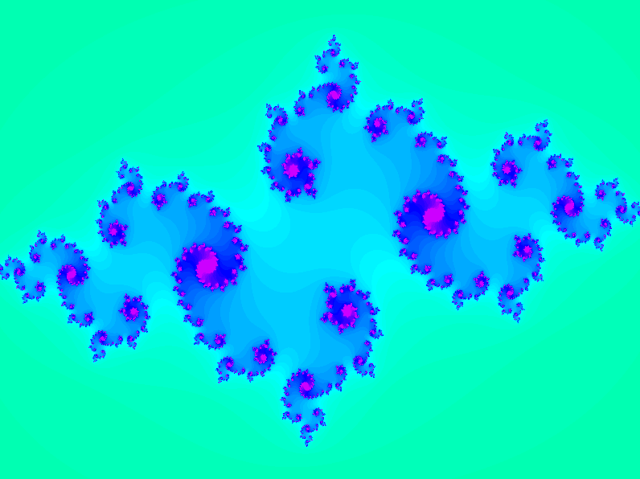
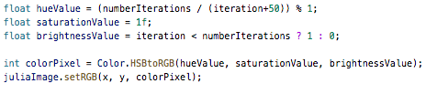
FRACTALS – Julia Fractal in the scene
C = -0.8 + 0.22015i
Number of iterations: 40.
This fractal was used as a texture in the sky sphere to give it a polluted feeling.
To set the color to each point we modified the Hue Value as shown.

Slide 28
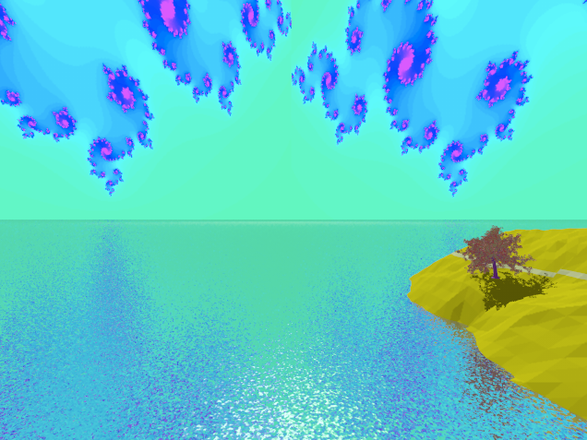
FRACTALS – Julia Fractal
We imported the Julia Set Result to POV as an PNG image.
We set the Julia Fractal in our scene as a pigment for the sky.
sky_sphere {
pigment { image_map {png "fractal2.png"} scale 1 } }

Slide 29
FRACTALS – terrain generation from Midpoint displacement
In order To create the terrain fractal, we implemented the midpoint displacement algorithm which follows:
We initialize the four corners of the heightmap to random values. A heightmap is a matrix with values corresponding to how high the placed point is according to the three dimensional coordinates of the plane.
Set the midpoints of each edge to the average of the two corners it’s between, plus or minus a random amount.
This random amount is calculated by multiplying a given amplitude value, a random parameter with values from -1 to 1 and 2 to the potency of a smoothing value multiplying the current size of the heightmap being calculated.

Slide 30
FRACTALS – terrain generation from Midpoint displacement
Set the center of the square to the average of those edge midpoints you just set, again with a random jitter.
Recurse on the four squares inside this one, reducing the jitter.

Slide 31
FRACTALS – Julia Fractal
The following is a part of our Julia fractal, doing what was previously described:>

Slide 32
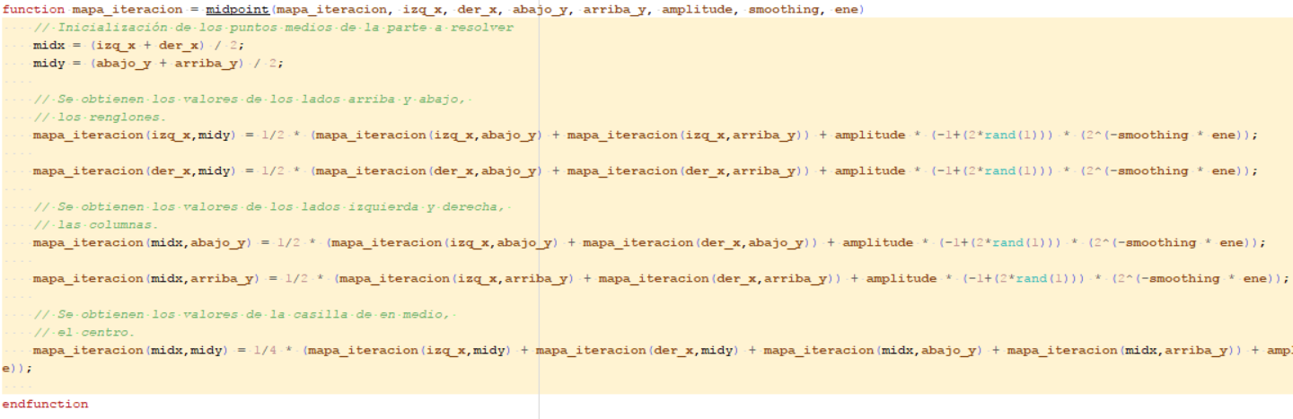
FRACTALS – terrain generation from Midpoint displacement
The following is a part of our algorithm, doing what was previously described:>

Slide 33
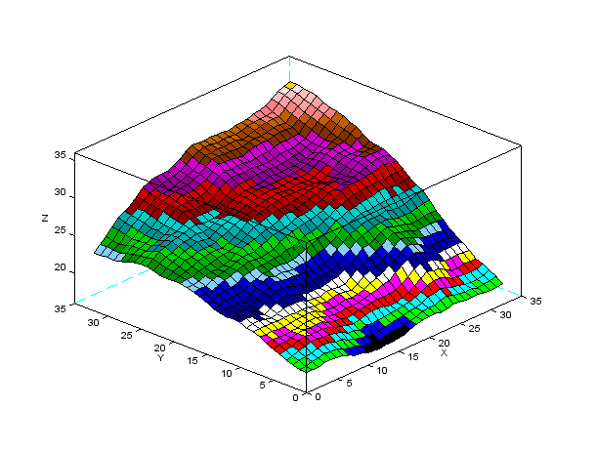
FRACTALS – terrain generation from Midpoint displacement
The following is a part of The result of the algorithm when run in scilab, describing ¼ of a mountain top:>

Slide 34
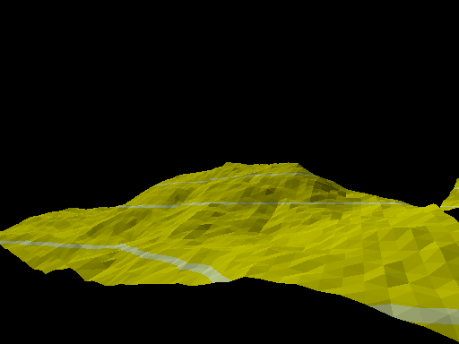
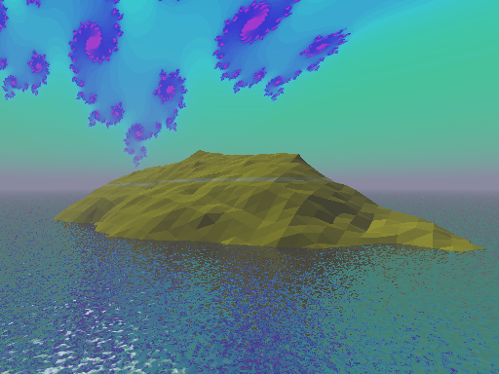
FRACTALS – terrain in our scene
At first, we used a previous homework to code the full algorithm, adding the random jitter to give it a realistic terrain feeling.
We implemented the result within our scene in the mountain we almost covered in water to show the flood from the rising sea levels covering earth.
We also placed a similar terrain to the side of our main small island for a more clutter sensation.

Slide 35
Colour and textures

Slide 36

Color Pallet

Slide 37
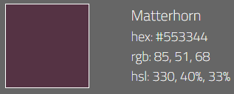
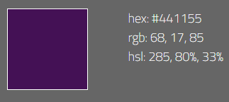
Color Pallet
It is known, that colors evoke certain emotions/feelings in humans. We applied the color pallet in our scene’s objects in order to give it a realistic look and expressing the feeling we want people to feel.
- Purple tones are used as a very alerting color. It is used to alert on the pollution on the air and trees. They are mainly used as an imaginative color for the disasters that took place.

Slide 38

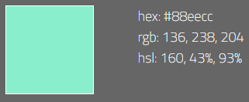
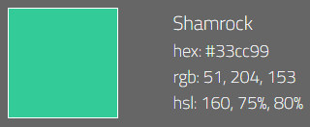
Color Pallet
- GREEN Tones, on the other hand, are usually a rather pleasant color. They represent nature (for obvious reasons and thus feels 'positive‘, 'good‘, ‘peaceful’ and ‘healthy’.

Slide 39
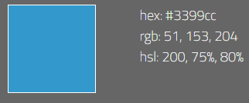

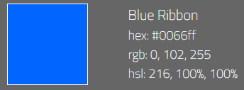
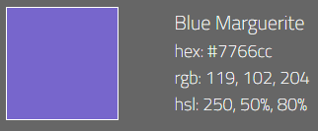
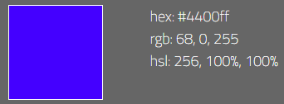
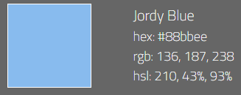
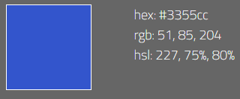
Color Pallet
- BLUE is a very pleasing hue as well, as it is another indicator for life: it reminds of water and the sky, two natural phenomenon which have been around us from the beginning.

Slide 40

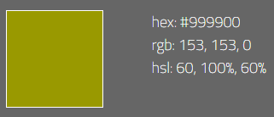

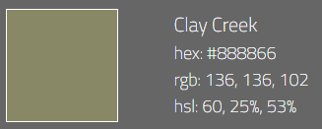
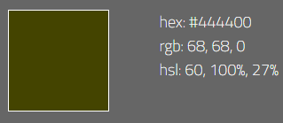
Color Pallet
- Brown and yellow are used a rugged appeal, creating a warm, inviting feeling in the trees and soil.

Slide 41
Color Pallet and textures
One more thing: the effects colors have on us are widely used in marketing; every brand that cares even a little bit for its appearance/impact, chooses its colors carefully. That's how strong different hues communicate a certain message.
We applied the colors we thought were the best in order to give our message about Environmental awareness. The application of the colors on the textures took its basis on this, trying to replicate reality and following the instructed principles of realism.

Slide 42
textures
The objective of the textures was to simplify the scene by giving a theme to a considerable part of the scene.
This would prevent the viewer of being overwhelmed by an excess in variety of colors.
We also used colorful textures, but with the use of light and fog, we managed to make them look darker, giving a good contrast to the scene.
All of the textures resembled real life objects’ colors, following the principle of realism of Believability as well as Specularity and Dirt, Dust and Rust, simplifying the way our message of environmental awareness is being carried over on the scene.
We will show the mountain, sky and water textures that helped us describe the general landscape of our scene.

Slide 43

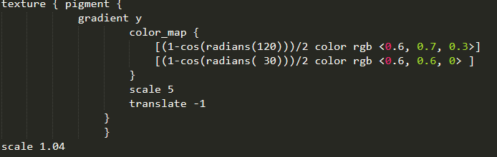
textures
We implemented the color pallet described in order to transmit our message.
A texture with green tones was used for the island, creating a sense of nature on it related to its previous form of a mountain before the catastrophic events that took place.
This particular texture was applied using color_map, a rather advanced way of applying textures from what we saw in class and during homework and tutorials.

Slide 44
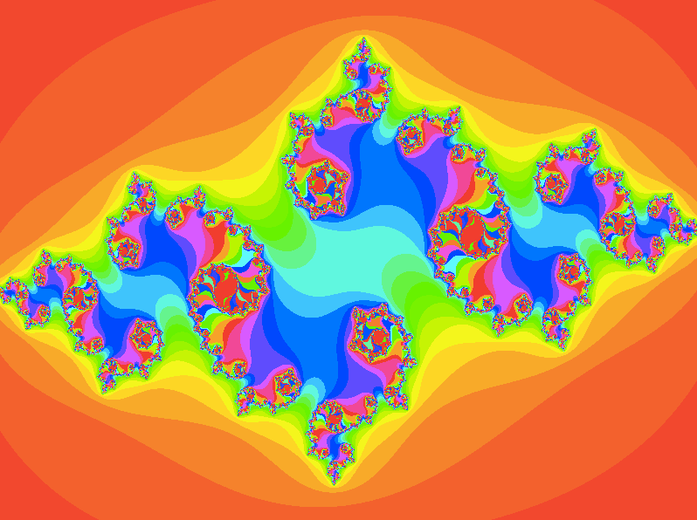
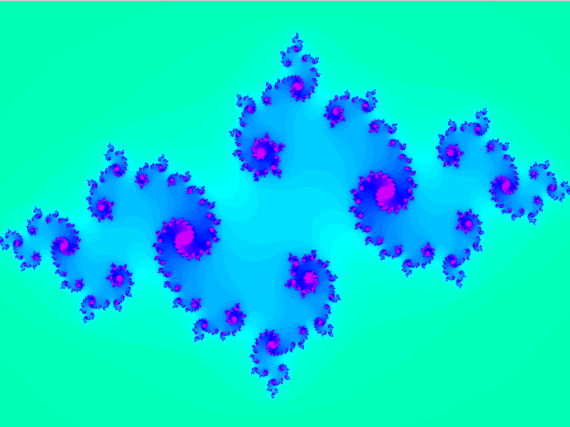
textures
Fractals were used as textures as well. The fractal with blue tones was used for the sky, matching the color pallet.
The other fractal, more orange, was used for the fruits, but in a darker tone to match the scene.
We used image_Map in order to import the texture correctly on the spheres, a different way of doing from what we saw in class. This texture originated from the fractal code we implemented before.

Slide 45
textures
In order to give our sea panel a realistic look, we added a natural water texture (we used polished chrome with bumps and turbulence, another technique we didn’t see in class).
This texture brings to life the panel that otherwise would be boring, following the principles of realism and, as we saw before, the reflecting and bouncing of light and shadows in the water help the scene show its natural feeling.

Slide 46
Principles of realism

Slide 47
1.- Clutter and chaos
We tried to implement as many principles as we could given our fantasy scene to make it more impactful to the viewer, however, we had many shortcomings such as time, a new modelling platform and objects within the scene that prevented us to take into account all of them to an acceptable degree for it to be counted here.
Our scene is not an ideal utopia of daily life but an extreme environment that challenges anyone inside it. The trees, the boat, the way the water surrounds the mountain show that it the scene wasn’t perfectly arranged.
The way the colors and textures mix show a feel of dirt and dust from the pollution.

Slide 48
1.- Clutter and chaos
It’s a natural state of living in a radical situation.

Slide 49
3.- Believability
The objects and surfaces in the scene are recognizable. The viewer would be familiar to trees, mountains, fruit, water, houses and boats. This scene can be understood by almost anyone with experience of the natural world, making it believable of its possible existence, even as a fantasy scene.

Slide 50
5.- Specularity
Our scene is shows the reflection of light from the polluted sky and the sun into the water, giving it a realistic feeling.

Slide 51
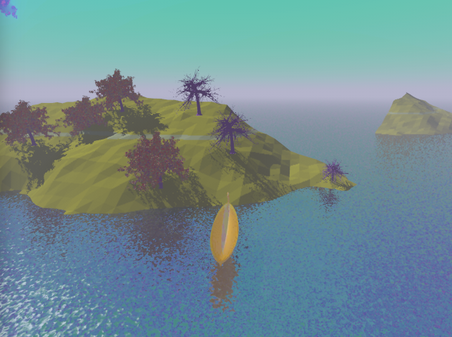
6.- Dirt, Dust and Rust & 7.- Flaws, Scratches & Dings
The surfaces on our scene have flaws in shape, texture and colors, applying these in different ways on the same objects, giving it a feeling that mimics reality. The colors used give it a rough look, as it was covered in pollution and dust. The fog in the scene also helps us achieve this principle.

Slide 52
Cameras

Slide 53
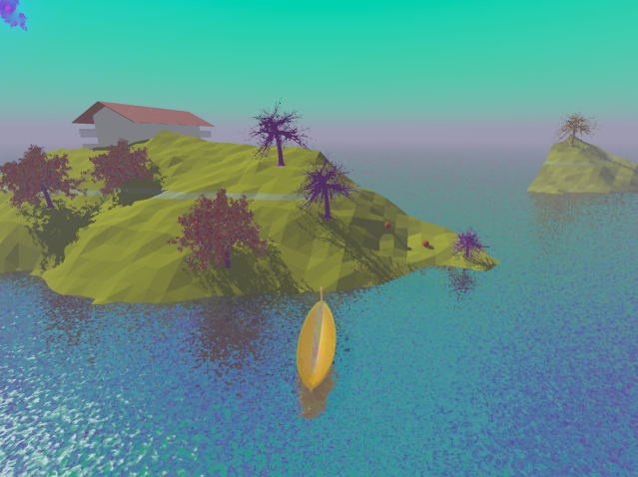
Cameras
We used cameras to show different angles, each one with an unique idea. The three principal ideas were:
Take from the boat perspective: a close up over the boat, The purpose of this camera position was to show a sense of “adventure” as if the boat was reaching the island for its first time along with people. The shadows from the sky on the water and its texture give it a realistic feeling of a boat being docked to a side of the island.

Slide 54
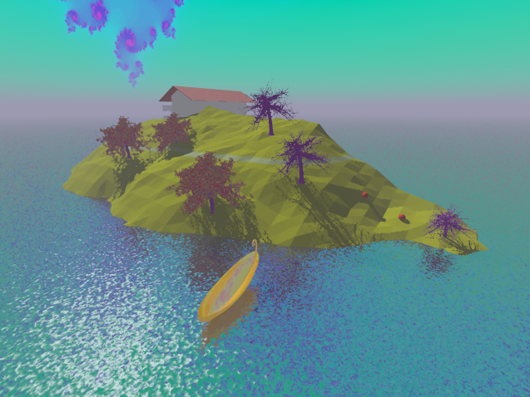
Cameras
Take from the main island: a point of view from a distance showing =the objects in the main island. The purpose of this camera was to show a more overwhelming impact. We used the fractal in a way that shows a disturbed world, from which the boat, who arrived previously, is now stuck in from the nothingness beyond. The way the trees’ shadows are reflected on the water gives the scene a natural feeling.

Slide 55
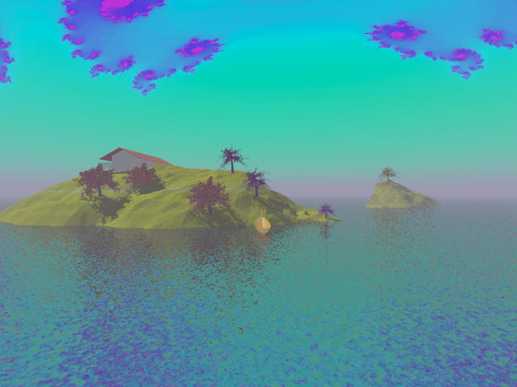
Cameras
Take from the whole scene: a point of view from a distance showing all the objects in the scene. On this final take, The purpose of this camera was to transmit the feeling that is not only that island but the world which is in that state of despair.
It also shows that there are other islands which may end in the same way, a fate on all the living creatures on earth. The shadows can be seen from both islands, keeping the realism principle of specularity on all the scene and the other takes.

Slide 56
Illumination

Slide 57
Illumination
Illumination was achieved by using light sources that reflected on water and interacted with the fog.
The objective was to show that even in these dark times, some light might be preserved. As hope can overcome the despair fate had brought upon the scene.

Slide 58
Illumination
In order to achieve this, we used white light with ambient and diffusion.
On this take, we use the angle of light to transmit less light and give a darker tone of despair and solitude to the scene.
We liked the way the shadows bounced on the water as we thought it was a very realistic look, as well as the shadows on the objects in the island and the boat on the sea.

Slide 59
The Scene

Slide 60
What does the scene mean?
As described before, the elements in our scene all have a purpose in mind with a common objective: show the possible repercussions of our actions on the overexploitation of natural resources and climate change.
we set up the cameras in such a way as to give us a general perspective of the principal elements of our scene.
We used the lights properties and fog in such a way to provide a dark and mysterious atmosphere.
We focused on what is happening WITH THE BOAT, AS IT IS THE SOURCE OF HOPE AND, AT THE SAME TIME, THE BURDEN OF DECISION TO EITHER STAY AND WAIT FOR HELP OR GOING OUT THE ISLAND AND LOOK FOR SURVIVORS AND RESOURCES.
The main light allowed us to create a perfect atmosphere where the shadows are very important to communicate the intention of a mysterious feeling.

Slide 61
What does the scene mean?
The house represents the current way of life and how, in this dire situation, will last a very short amount of time as its resources start to deplete.
The flood covering the scene is related to the increasing sea levels that the rising temperatures from climate change are affecting the icebergs formation in the poles.
The trees with its rotten fruits show how the impact is not only on the sea level but on the green gases in the atmosphere that change the way trees grow, from growing leaves to fruits.

Slide 64
Conclusions

Slide 65
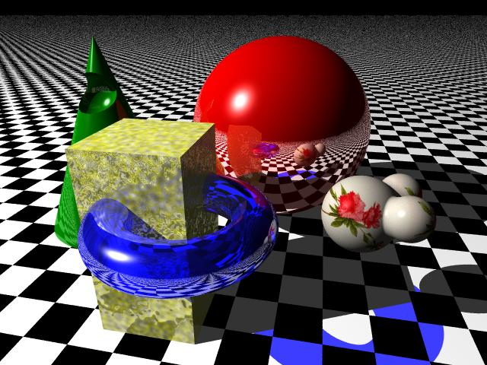
Technical Conclusions
While first using POV Ray, we encountered us with a change of paradigm compared to what we were doing in Blender. It was a challenge to go from moving and seeing your models to having to position them before rendering.
However, once we saw the potential of POV Ray related to the variety and complexity of achievable shapes, textures and use of mathematical methods and programming reuse of assets, it was clear that knowing to use more advanced programs definitely has its benefits.

Slide 66
Technical Conclusions
Some technical difficulties we found were mostly on textures, camera positioning and compositions. Using models from external sources was a challenge in istelf due to understanding the way the authors of the files used primitives to achieve the objects.
However, we found interesting the different features that each rendering option offers and the variety of compositions. Finding the right lighting and the right angle to show our work was also a very tiring but worthwhile task as we could see clearly our work take shape as we wanted it to do.
This Teamwork based project helped us put into practice the different lessons learned from the very beginning even when we had to implement them now in a different software, contemplating all the topics reviewed. Also, this activity made us think critically about different subjects that might not seem at first hand related to the course, but can be a part of it if we PUT OUR CREATIVITY INTO IT.

Slide 67
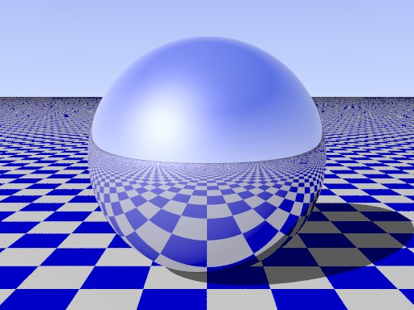
Technical Conclusions
This way of approaching the Project made us discuss and find a common way of thinking to imagine the open environment to represent.
We found that the models, lighting, shadows, cameras and different tools can help shape and represent an idea within a closed room and learning how they work in povray was rewarding.
We would like to take part in projects with a similar approach if possible, as it is quite satisfactory to reach a common ground and see it take shape as we imagined it even if we face technical difficulties in our way there.

Slide 68
Ethical Conclusions
Our project tries to demonstrate the impact that overexplotation of resources and not worrying about the repercursions have on our cultural context, Specifically in how an not doing anything could lead us to a life where we seek immediate pleasure without thinking on other factors.
It also shows how the spontaneous pleasures are darkening the judgement of people, which can cause neglecting actions that could help others in the long run instead of ourselves.
AS said by Epicurus, “If a little is not enough for you, nothing is.”, This new philosophy of the market of pleasure revolves around the idea of being ‘untroubled’ over the positive experiences of pleasure, looking for them exclusively and selfishly, hiding worries and pains in order to feel most pleasure. (Retrieved from: http://www.spring.org.uk/2007/12/hedonist-philosopher-epicurus-was-right.php)

Slide 69

Ethical Conclusions
This way of life can hinder our capabilities and desires, ignoring our moral responsibility to live within a society, looking out for people around us. Instead, this way of thinking is selfish and individualist as someone being led by it only cares about themselves.

Slide 70

Ethical Conclusions
One of the aspects that we would like to highlight from POVRay is how easy is to import content from other sources. However, it’s critical that if we use the work of another person, we reference that content and use it only on an ethical background, respecting the desires of the creator and the laws behind Creative Commons)(Sci leo, 2013) .

Slide 71
Citizenship Conclusions
With the scene we try to transmit a sense of “I-Thou” (Vialogue, 2008)), meaning that we as a society are related to everything around us, including others. For this reason, escaping from a decayed society would not be ethical towards others.
We try to make the user feel that escaping is not the ideal outcome and that if we as society unite we could fix any problem.
The decisions of leaving or staying in the island is a burden that we want to emphasize to prevent an event of this magnitude happening.
Elements like the dead trees and fruits, elements of nature, have been corrupted by vices we keep carrying on.

Slide 72
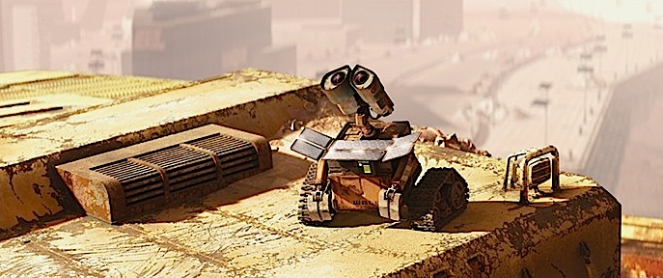
Citizenship Conclusions
Also, the setting of the scene being(closed and dark)relates with citizens worrying less and being less optimistic about doing something that could help the outside world and our society, preferring an individual way of living.
This way of thinking AND ACTING ultimately doesn't solve society problems and may actually be the source of many.

Slide 73
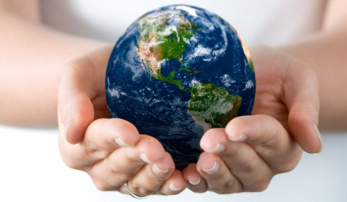
Environmental Conclusions
This is the core of the scene. We try to make the viewer think about the impact that humans have on nature and how humankind will inevitably be affected at some point, to the extreme of even causing extinction (Livestrong, 2017). For us, this is an abstraction of global warming.
The use of fog and the fractal sky give a sense of an altered reality because of problems caused by mankind, such a pollution, greenhouse gases, ozone layer depletion and climate change. We want the viewer to be aware of how much impact we can have on reality.

Slide 74
Environmental Conclusions
although we have serious environmental problems, our efforts to change our habits are very small compared to the damage done.
We selected the hellish sky and trees to represent the chaotic nature of environmental problems and catastrophes led by the overconsumption of resources in our planet.
We should try our hardest to protect and preserve the natural resources the world has given us.

Slide 75
Project Conclusions
We accomplished the purposes of our project as we:
Translated the knowledge learned in class and on assignments into a scene using tools and methods that were relatively new to us.
We had to work and think of innovative ways to use povray in order to transmit the ideas we had.
We also had to work together as a team and collaborate in order to achieve satisfactory final results.

Slide 76
Credits – Models and textures
Boat by Mick Hazelgrove: http://objects.povworld.org/cgi-bin/dl.cgi?boat.pov-
Livestrong (2017). Future effects of pollution: https://www.livestrong.com/article/268337-future-effects-of-pollution
Pescola Lighthouse by Bob Hughes: http://objects.povworld.org/objects/cgi-bin/dl.cgi?lighthouse.zip
Sci Elo (2013). Publication ethics and the problem of plagiarism: http://blog.scielo.org/en/2013/10/02/publication-ethics-and-the-problem-of-plagiarism/#.WfoWh2hSxPY
Vialogue (2008). Wall-E: More Than Just The Environment – How Robots Teach Us How To Be Human: https://vialogue.wordpress.com/2008/07/11/wall-e-more-than-just-the-environment/

